Slide 1
Rehabilitative experiences of ex- prisoners in India: the push for a central prison reform programme
BSc Social sciences, institute of education
By: Siri Rajesh Reddy
Supervised by: Dr Matteo Tiratelli

Slide 2
The Indian Prison System (IPS)
Figure 1: Overview of the Indian Prison System (NCRB, 2020b)

Slide 3
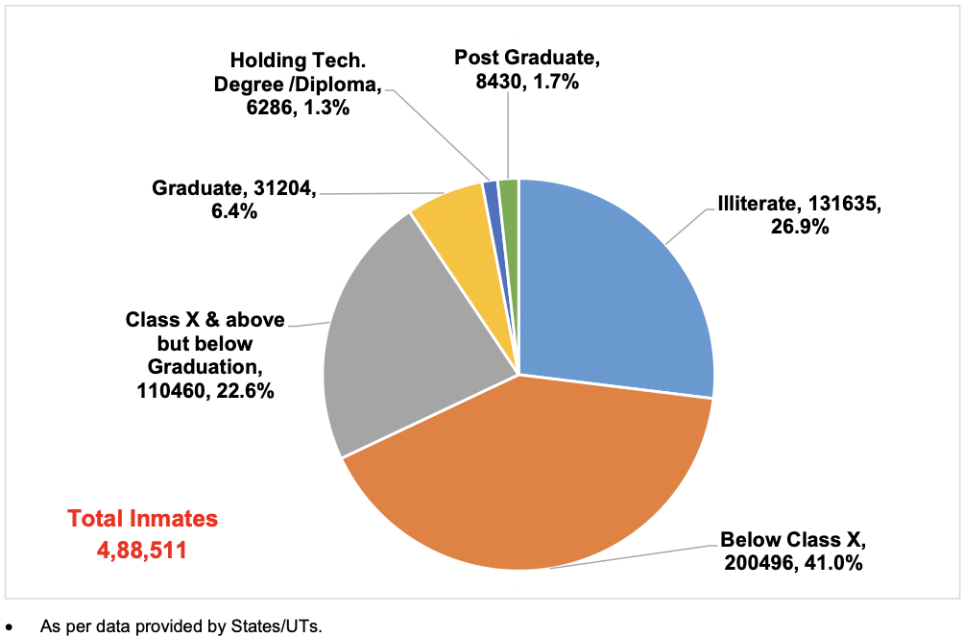
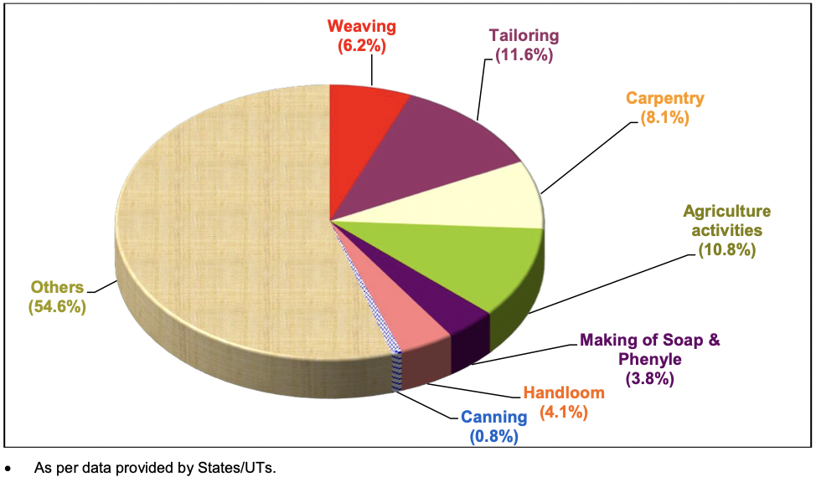
Problem
Only 0.3% of prisoners in India are successfully rehabilitated, 17% receive educational support and 8.8% vocational training (NCRB, 2020).
Figure 2: Educational Profile of Prisoners (NCRB, 2020b)
Figure 3: Percentage of Prisoners by the type of Vocational Training (NCRB, 2020b)

Slide 4
Literature Review
Why? (Nagda, 2017; Nair, 2016):
Outdated laws
Corruption
No central authority or prison reform programme
A lack of finance and resources
Current rehabilitation support (Human Rights Commission, 2005):
State government programmes are short-term, sporadic, outdated, not evidence or research based, focus on extra-curriculars, differ vastly, and exclude the needs of women, juvenile, vulnerable and illiterate prisoners.
879 NGOs bridge this gap but face the same challenges above due to a lack of finance and government support.
Benefits of rehabilitation:
Any form of education in prison improves prisoners’ employment opportunities post-release, political engagement, volunteerism, and health (Bender, 2018; Davis et al., 2018).
Reduce recidivism and improves reintegration (Manikandan, 2017).
Government response (Peterson & Lee, 2017):
The Model Prison Manual outlines prison conduct guidelines in India but it is not holistic or comprehensive.
The Supreme Court is pushing for the development of a central prison reform programme, ‘All India Jail Manual’.
It should be “evidence or research based, cost-effective and focus on the needs and challenges” of prisoners.

Slide 5
Research Gap and Questions
Limited literature in India on:
The role of NGOs
Prisoners’ experiences, especially of women
Post-release support
Aims:
Understand the rehabilitative experiences of female ex-prisoners in India and impact of post-release integration.
Examine the views of NGO employees and their policy recommendations.
Analyse the ‘Restorative Justice Model’ used in Norway’s prisons to be applied to the IPS in a cost-effective manner.
Provide a foundation for the development of a central prison reform programme (All India Jail Manual).
Research Questions (RQ):
What are the experiences of ex-prisoners in India undertaking rehabilitative programmes and how has this supported their reintegration into society?
What are the experiences and views of NGO employees and trainers designing, implementing, and delivering rehabilitative programmes in India?
How can a central prison reform programme (All India Jail Manual) be developed based on ex-prisoners’ and NGO employees experiences?

Slide 6
Method
Participant recruitment:
Opportunity sampling (7 NGOs and the Bangalore Central Prison).
Prayas in Mumbai and India Vision Foundation (IVF) in Delhi selected.
Data collection:
18 semi-structured interviews.
Oral interviews with 7 NGO employees from Prayas.
Written interviews with 6 female ex-prisoners and 5 with NGO employees from IVF.
Participant information:
Education level: no education to grade level 10 with most uneducated (4).
Convictions: Domestic abuse (1), abetment of suicide (1), rape (1) and murder (3).
Duration in prison: Between 3 months to 7 years with the average being 3.8 years.
NGO employees: In Prayas, NGO employees were social (4), case (2) or field workers (1) whereas in IVF, they were project coordinators (2), assistant managers (2), and the head of the Learning & Development (L&D) team (1).
Analysis
Interview transcripts and written responses analysed through thematic analysis where 54 codes were developed.

Slide 7
Results (Rehabilitative support offered)
Government: did not provide rehabilitative support in prisons or post-release.
NGOs: vocational training, education, literacy training, extra-curricular activities, counselling, health assistance, and family and child support alongside post-release and Covid-19 support.
Prayas vs IVF: more legal, aid and finance by Prayas whereas more computer training, mental wellness, and culture and awareness programmes were provided by IVF.
Delhi vs Mumbai: No region-specific differences.
Quotes:
“I never thought that I would ever go to jail and such programs would also be going on there” (E).
“Why would NGOs exist if the government did its job?” (P)
“Governments have no interest and are strict with process” (P) and there often is “no response from police officers” as “they simply say why are you helping her, she is a dirty woman, she is a criminal, you’re simply wasting your time” (M).
“What I could not do while living outside, I found it inside” (F).
“Before coming to jail, I was fifth grade pass from Calcutta and I did not know how to read and write Hindi. When I went to jail, I took admission in adult education and passed eighth grade inside the jail itself” (E).

Slide 8
RQ1: Experiences of ex-prisoners
Challenges faced:
Prisons: Poor mental health (depression and stress), missing their children and demotivation.
Post-release: Unemployment, no social support and responsibility of children.
Benefits of rehabilitative programs:
Positively influenced prisoners mental health, physical health, behavior, and mindset.
Vocational training (stitching and sewing) helped ex-prisoners obtain employment post-release.
When Covid-19 resulted in job losses, they were able to use those skills to become entrepreneurs.
Making them independent or self-reliant.
Desire:
Stitching, sewing and computer training.
Quotes:
“When we were involved in the activities, we forget all thoughts and release all the depression” (C).
“Today I am a husband earning money from this sewing and I am able to take care of children” (F).
“I wanted to learn sewing even before coming to jail, and I got this opportunity inside” (F)
“I sew clothes on order at home” (D) and “I was not even getting any sewing work, so I made and sold masks” (F).

Slide 9
RQ2: Experiences of NGO employees
Criminal intent:
Substance abuse
Lack of education
No social support
Mental disorders or brain impairments
History of domestic violence or abuse for women
Challenges faced:
Demotivated prisoners.
Lack of coordination in the CJS.
No support from the government prison administration team.
Quotes:
“Take a wrong step only when he is not able to differentiate between good and bad or he lacks education and skills, and all these programs make a person complete” (H).
”Female inmates’ family doesn’t support them so they live in stress” (K).
“The person is sentenced to many years and they get depressed or very sick, yet at those times you can’t do anything” (J).

Slide 10
RQ3: Policy recommendations
Infrastructure: Social welfare office for prisoner rehabilitation and reintegration support.
Individual: counselling, vocational training, financial assistance.
Character certificate: ascertaining an individual’s rehabilitative progress.
Legal aid: procurement of relevant documents and government welfare scheme awareness workshops.
Tailored support for women: female doctors, personal hygiene products and child support.
Quotes:
“Motor repair maintenance, high education programs like tele, data entry and steno programs, cooking programs etc that will help them to get better jobs” (K).
“Character certificates should also be provided by the jail administration and is valid in the community and society” (H).
“Love, respect and dignity will help an ex-prisoner to look forward in life with hope, positivity and crime free future” (M).

Slide 11
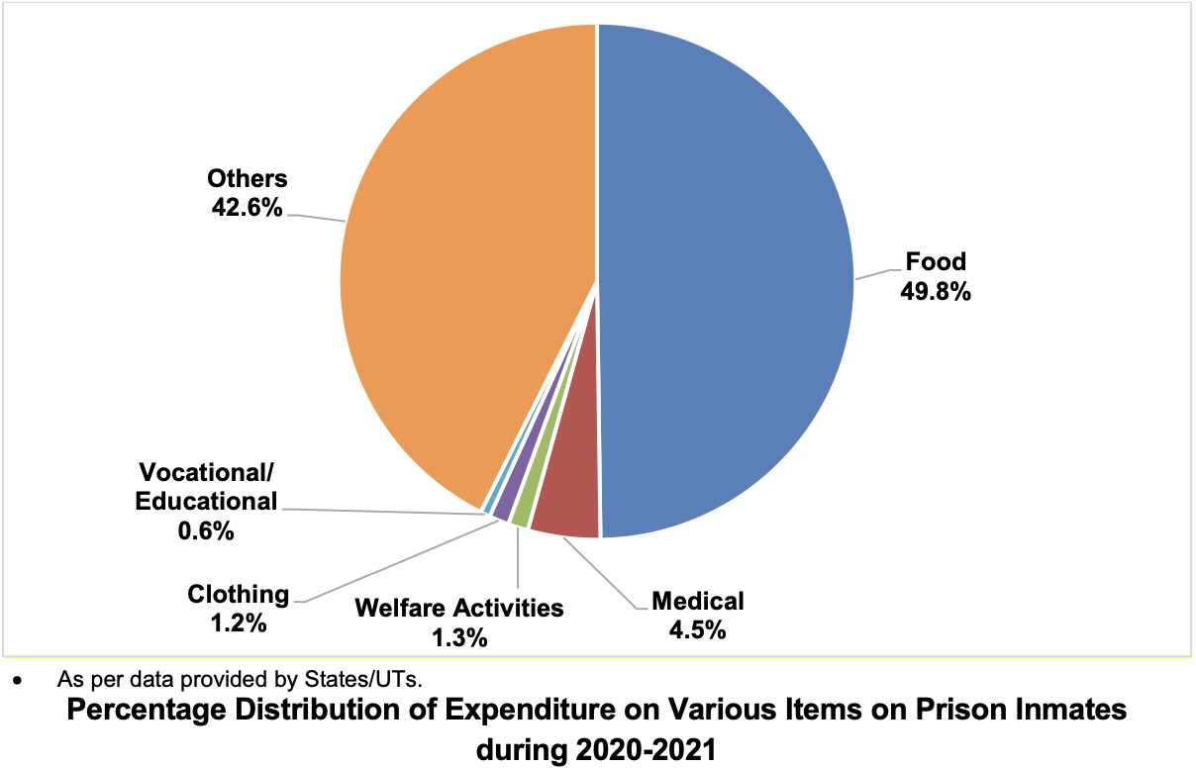
Applying the ‘Restorative Justice Model’
‘Restorative Justice Model’ (Bhuller, Dahl & Loken, 2019):
Shorter prison sentences
Improvement of prison conditions
Prison safety
Cost-effectiveness:
Norway spends £97,000 per prisoner compared to £2,000 in India.
86.3% of (£63M) of the budget in India was spent in 2020 but only 1.9% (£1.4M) used on rehabilitative support.
Figure 4: Percentage of expenditure on Prisoner Items 2020-21 (NCRB, 2020b)

Slide 12
Evaluation
Subjective experiences:
Only female ex-prisoners under serious convictions interviewed.
Vary based on sentences, age, location, gender, socio-economic status, offences, and types.
Prison administrators were not interviewed resulting in bias towards NGOs.
Interviews:
Written interviews elicited shorter and less detailed responses.
Participants reported positively about IVF as they were interviewed by gatekeepers.
Translation from Hindi to English may result in participants’ feelings being inaccurately represented (van Nes et al., 2010).
Reductionist:
Prison reform limited to vocational training, education, literacy, mental health support and counselling.
Need to include prison infrastructure or medical care for a holistic programme.
Context:
Application of the Norway prison system and its cost-effectiveness in the context of a developing country, India.

Slide 13
All India Jail Manual
Advocates for the development of a central prison reform programme:
In collaboration with the CJS and NGOs.
Addressing the needs and challenges of ex-prisoners, particularly females.
Incorporating policy recommendations by NGO employees.
Applying key features of the Norway ‘Restorative Justice Model’.
Replacing the Prison Act (1894) with a central law to ensure uniformity.
“Be holistic and comprehensive that should aim at crimefree society with equality & equity, respect, and dignity for all. There should be inclusivity for everyone with a fair chance of redemption” (H).

